Slide 1
Chapter 5: Advanced SQL

Slide 2
Outline
Accessing SQL From a Programming Language
Functions and Procedural Constructs
Triggers
Advanced Aggregation Features
OLAP

Slide 3
Accessing SQL From a Programming Language

Slide 4
Accessing SQL From a Programming Language
C/C++
Java
Python
Interface
Databases

Slide 5
Accessing SQL From a Programming Language
C/C++
Java
Python
JDBC/ODBC
Databases

Slide 6
Accessing SQL From a Programming Language
API (application-program interface) for a program to interact with a database server
Application makes calls to
  Connect with the database server
  Send SQL commands to the database server
  Fetch tuples of result one-by-one into program variables
Various tools:
  JDBC (Java Database Connectivity) works with Java
  ODBC (Open Database Connectivity) works with C, C++, C#, and Visual Basic. Other API’s such as ADO.NET sit on top of ODBC
  Embedded SQL
Dynamic SQL

Slide 7
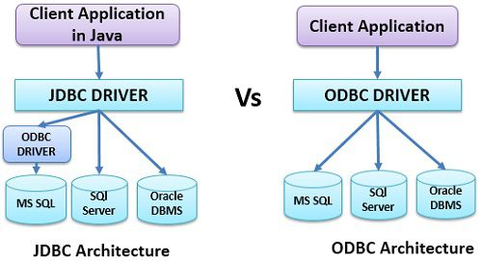
JDBC vs ODBC
Source (click here)

Slide 8
JDBC
JDBC is a Java API for communicating with database systems supporting SQL.
JDBC supports a variety of features for querying and updating data, and for retrieving query results.
JDBC also supports metadata retrieval, such as querying about relations present in the database and the names and types of relation attributes.
Model for communicating with the database:
  Open a connection
  Create a “statement” object
  Execute queries using the Statement object to send queries and fetch results
  Exception mechanism to handle errors

Slide 9
ODBC
Open DataBase Connectivity (ODBC) standard
  standard for application program to communicate with a database server.
  application program interface (API) to
    open a connection with a database,
    send queries and updates,
    get back results.
Applications such as GUI, spreadsheets, etc. can use ODBC

Slide 10
Embedded SQL
The SQL standard defines embeddings of SQL in a variety of programming languages such as C, C++, Java, Fortran, and PL/1,
A language to which SQL queries are embedded is referred to as a host language, and the SQL structures permitted in the host language comprise embedded SQL.
EXEC SQL statement is used to identify embedded SQL request to the preprocessor
EXEC SQL <embedded SQL statement >;
Note: this varies by language:
  In some languages, like COBOL, the semicolon is replaced with END-EXEC
  In Java embedding uses # SQL { …. };

Slide 11
Embedded SQL (Cont.)
Before executing any SQL statements, the program must first connect to the database. This is done using:
EXEC-SQL connect to server user user-name using password;
Here, server identifies the server to which a connection is to be established.
Variables of the host language can be used within embedded SQL statements. They are preceded by a colon (:) to distinguish from SQL variables (e.g., :credit_amount )
Variables used as above must be declared within DECLARE section, as illustrated below. The syntax for declaring the variables, however, follows the usual host language syntax.
EXEC-SQL BEGIN DECLARE SECTION
int credit-amount ;
EXEC-SQL END DECLARE SECTION;
Details: IBM Embeded SQl in C++

Slide 12
Embedded SQL (Cont.)
To write an embedded SQL query, we use the
declare c cursor for <SQL query>
statement. The variable c is used to identify the query- temporary work area Example:
  From within a host language, find the ID and name of students who have completed more than the number of credits stored in variable credit_amount in the host langue
  Specify the query in SQL as follows:
  EXEC SQL
  declare c cursor for
  select ID, name
  from student
  where tot_cred > :credit_amount
  END_EXEC
The variable c (used in the cursor declaration) is used to identify the query- pointer to context area storing select result

Slide 13
Embedded SQL (Cont.)
The open statement for our example is as follows:
EXEC SQL open c ;
This statement causes the database system to execute the query and to save the results within a temporary relation. The query uses the value of the host-language variable credit-amount at the time the open statement is executed.
The fetch statement causes the values of one tuple in the query result to be placed on host language variables.
EXEC SQL fetch c into :si, :sn END_EXEC - points to next tuple
Repeated calls to fetch get successive tuples in the query result

Slide 14
Embedded SQL (Cont.)
A variable called SQLSTATE in the SQL communication area (SQLCA) gets set to ‘02000’ to indicate no more data is available
The close statement causes the database system to delete the temporary relation that holds the result of the query.
EXEC SQL close c ;
Note: above details vary with language. For example, the Java embedding defines Java iterators to step through result tuples.

Slide 15
Updates Through Embedded SQL
Embedded SQL expressions for database modification (update, insert, and delete)
Can update tuples fetched by cursor by declaring that the cursor is for update
EXEC SQL
declare c cursor for
select *
from instructor
where dept_name = ‘Music’
for update
We then iterate through the tuples by performing fetch operations on the cursor (as illustrated earlier), and after fetching each tuple we execute the following code:
update instructor
set salary = salary + 1000
where current of c

Slide 16
Extensions to SQL

Slide 17
Extensions to SQL
SQL supports functions and procedures
SQL also supports a rich set of imperative constructs, including
  Loops,
  if-then-else
  Case Statements
  Assignment

Slide 18
Functions and Procedures
When do we use user defined function or procedure:
  Some statements need to be executed frequently
  Dynamic statements- different statement for different parameters

Slide 19
Functions and Procedures in SQL or Host Language?
functions in Host/external language
  Functions written in an external languages are particularly useful with specialized data types such as images and geometric objects.
    Example: functions to check if polygons overlap, or to compare images for similarity.
functions and procedure in SQL
  Give name to a group of SQL statement- avoid rewriting them frequently.
  You can call the functions( large set of SQL queries) in another query
  Some database systems support table-valued functions, which can return a relation as a result.

Slide 20
SQL Functions
Define a function that, given the name of a department, returns the count of the number of instructors in that department.
create function dept_count (dept_name varchar(20))
returns integer
begin
declare d_count integer;
select count (* ) into d_count
from instructor
where instructor.dept_name = dept_name;
return d_count;
end
The function dept_count can be used to find the department names and budget of all departments with more that 1 instructors.
select dept_name, budget from department where dept_count (dept_name ) >=2

Slide 21

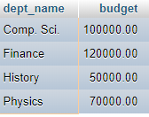
SQL Functions
dept_count
Comp. Sci.
3
select dept_name, budget from department where dept_count (dept_name ) >=2

Slide 22
SQL Functions
Mysql/MariaDB version
DELIMITER //
create function dept_count(dept_name varchar(20))
returns integer
begin
declare d_count integer;
select count(*) into d_count from instructor where instructor.dept_name = dept_name;
return d_count;
end //
DELIMITER ;
Default delimiter ( end of query) is semicolon ‘;’ . In compound statement (begin … end) , to keep semicolon as delimiter you have to change delimiter for whole query using DELIMITER.
MariaDB documentation

Slide 23

Quiz
Create a function that takes a department as a paramenter and returns the average salary of the department
Go to Quizzes in Black board -> Quiz3

Slide 24
SQL functions (Cont.)
Compound statement: begin … end
  May contain multiple SQL statements between begin and end.
returns -- indicates the variable-type that is returned (e.g., integer)
return -- specifies the values that are to be returned as result of invoking the function
SQL function are in fact parameterized views that generalize the regular notion of views by allowing parameters.

Slide 25
SQL functions - parameterized views
SQL function are in fact parameterized views that generalize the regular notion of views by allowing parameters.
View:
create view instructor_count as select count(*) from instructor where instructor.dept_name =“Biology”
Function for same Purpose:
create function dept_count (dept_name varchar(20))
returns integer
begin
declare d_count integer;
select count (* ) into d_count
from instructor
where instructor.dept_name = dept_name;
return d_count;
end
- Functions are parameterized or dynamic views

Slide 26
Table Functions
SQL:2003 added functions that return a relation as a result
Example: Return all instructors in a given department
create function instructor_of (dept_name char(20))
returns table (
ID varchar(5),
name varchar(20),
dept_name varchar(20),
salary numeric(8,2))
return table
(select ID, name, dept_name, salary
from instructor
where instructor.dept_name = instructor_of.dept_name)
Usage
select *
from table (instructor_of (‘Music’))

Slide 27
SQL Procedures
The dept_count function could instead be written as procedure:
create procedure dept_count_proc (in dept_name varchar(20),
out d_count integer)
begin
select count(*) into d_count
from instructor
where instructor.dept_name = dept_count_proc.dept_name
end
Procedures can be invoked either from an SQL procedure/function or from embedded SQL, using the call statement.
declare d_count integer;
call dept_count_proc( ‘Physics’, d_count);
Procedures and functions can be invoked also from dynamic SQL
SQL:1999 allows more than one function/procedure of the same name (called name overloading), as long as the number of
arguments differ, or at least the types of the arguments differ
Notes:
DELIMITER //
create procedure dept_count_proc (in dept_name varchar(20), out d_count integer)
begin
select count(*) into d_count from instructor where instructor.dept_name = dept_count_proc.dept_name;
end
DELIMITER ;

Slide 28
Procedure in MySQL/MariaDB
DELIMITER //
create procedure dept_count_proc (in dept_name varchar(20), out d_count integer)
begin
select count(*) into d_count from instructor where instructor.dept_name = dept_name;
end //
DELIMITER ;
Calling Procedure
set @dept_name="History";
call dept_count_proc(@dept_name, @inst_count);
select @inst_count;
Procedure Cannot be invoked in another query.

Slide 29
Procedures vs Functions
Function | Procedure
must return a value | optional
Only input parameters | Both input and output parameters
Usually, not used for Database modification- but possible. | Frequently used for database modification- update, delete, insert
Can be used in another query | Cannot call in another query. Use call key word to invoke a procedure.
No Exception handling, transactions | Exception handling, transactions
Notes:
DELIMITER //
create procedure dept_count_proc (in dept_name varchar(20), out d_count integer)
begin
select count(*) into d_count from instructor where instructor.dept_name = dept_count_proc.dept_name;
end
DELIMITER ;

Slide 30
Language Constructs for Procedures & Functions
SQL supports constructs that gives it almost all the power of a general-purpose programming language.
  Warning: most database systems implement their own variant of the standard syntax below.
Compound statement: begin … end,
  May contain multiple SQL statements between begin and end.
  Local variables can be declared within a compound statements
While and repeat statements:
  while boolean expression do
    sequence of statements ;
  end while
  repeat
    sequence of statements ;
  until boolean expression
  end repeat

Slide 31
Language Constructs (Cont.)
For loop
  Permits iteration over all results of a query
Example: Find the budget of all departments
declare n integer default 0;
for r as
select budget from department
do
set n = n + r.budget
end for
Sample MariaDB Code segment:
DELIMITER //
CREATE PROCEDURE dowhile()
BEGIN
DECLARE v1 integer;
set v1 = 5;
WHILE v1 > 0 DO
SET v1 = v1 - 1;
SELECT v1;
END WHILE;
END //
delimiter ;

Slide 32
Language Constructs (Cont.)
Conditional statements (if-then-else)
SQL:1999 also supports a case statement similar to C case statement
Exception handling is also available
DELIMITER //
CREATE FUNCTION PageCount ( value INT )
RETURNS varchar(10) DETERMINISTIC // deterministic : same output for same input- randomness in function can make it non-deterministic
BEGIN
DECLARE level varchar(20);
IF value < 500 THEN
SET level = 'Low';
ELSEIF value >= 500 AND value <= 4000 THEN
SET level = 'Medium';
ELSE
SET level = 'High';
END IF;
RETURN level;
END; //
DELIMITER ;
Source: https://www.techonthenet.com/mariadb/loops/if_then.php

Slide 33
Triggers

Slide 34
Triggers
A trigger is a statement that is executed automatically by the system as a side effect of a modification to the database.
To design a trigger mechanism, we must:
  Specify the conditions under which the trigger is to be executed.
  Specify the actions to be taken when the trigger executes.

Slide 35
Triggering Events and Actions in SQL
Triggering event can be insert, delete or update
Triggers on update can be restricted to specific attributes
  For example, after update of takes on grade
ID | Name | Dept_name | total_ Earned_Credit
34563 | CS33007 | 1 | 50
56723 | CS33007 | 1 | 60
student
ID | Course_id | Sec_id | Semester | Year | grade
34563 | CS33007 | 1 | Spring | 2020 | NULL
56723 | CS33007 | 1 | Spring | 2020 | A
takes

Slide 36
Triggering Events and Actions in SQL
Triggering event can be insert, delete or update
Triggers on update can be restricted to specific attributes
  For example, after update of takes on grade
ID | Name | Dept_name | total_ Earned_Credit
34563 | CS33007 | 1 | 50
56723 | CS33007 | 1 | 60
student
Change the grade of 34563 to F or B. – You might need to update total earned credit as well.
ID | Course_id | Sec_id | Semester | Year | grade
34563 | CS33007 | 1 | Spring | 2020 | B
56723 | CS33007 | 1 | Spring | 2020 | A
takes

Slide 37
Triggering Events and Actions in SQL
Triggering event can be insert, delete or update
Triggers on update can be restricted to specific attributes
  For example, after update of takes on grade
ID | Name | Dept_name | total_ Earned_Credit
34563 | CS33007 | 1 | 50+3 = 53
56723 | CS33007 | 1 | 60
student
Change the grade of 34563 to F or B. – You might need to update total earned credit as well.
Say, Credit of CS3307 is 3
ID | Course_id | Sec_id | Semester | Year | grade
34563 | CS33007 | 1 | Spring | 2020 | B
56723 | CS33007 | 1 | Spring | 2020 | A
takes

Slide 38
Triggering Events and Actions in SQL
Triggering event can be insert, delete or update
Triggers on update can be restricted to specific attributes
  For example, after update of takes on grade
ID | Name | Dept_name | total_ Earned_Credit
34563 | CS33007 | 1 | 50+3 = 53
56723 | CS33007 | 1 | 60
student
Change the grade of 34563 to F or B. – You might need to update total earned credit as well.
Say, Credit of CS3307 is 3
ID | Course_id | Sec_id | Semester | Year | grade
34563 | CS33007 | 1 | Spring | 2020 | B
56723 | CS33007 | 1 | Spring | 2020 | A
takes
Values of attributes before and after an update can be referenced
  referencing old row as : for deletes and updates
  referencing new row as : for inserts and updates
Old.grade = NULL
New.grade = B

Slide 39
Triggering Events and Actions in SQL
Triggering event can be insert, delete or update
Triggers on update can be restricted to specific attributes
  For example, after update of takes on grade
Values of attributes before and after an update can be referenced
  referencing old row as : for deletes and updates
  referencing new row as : for inserts and updates
ID | Name | Dept_name | total_ Earned_Credit
34563 | CS33007 | 1 | 50
56723 | CS33007 | 1 | 60
ID | Course_id | Sec_id | Semester | Year | grade
34563 | CS33007 | 1 | Spring | 2020 | NULL
56723 | CS33007 | 1 | Spring | 2020 | A

Slide 40
Trigger Example
Triggers can be used to implement certain integrity constraints
CREATE TABLE people (age INT, name varchar(150));
delimiter //
CREATE TRIGGER agecheck BEFORE INSERT ON people
FOR EACH ROW
IF NEW.age < 0 THEN
SET NEW.age = 0;
END IF;//
delimiter ;
INSERT INTO people VALUES (-20, ‘Sid’), (30, ‘Josh’);

Slide 41
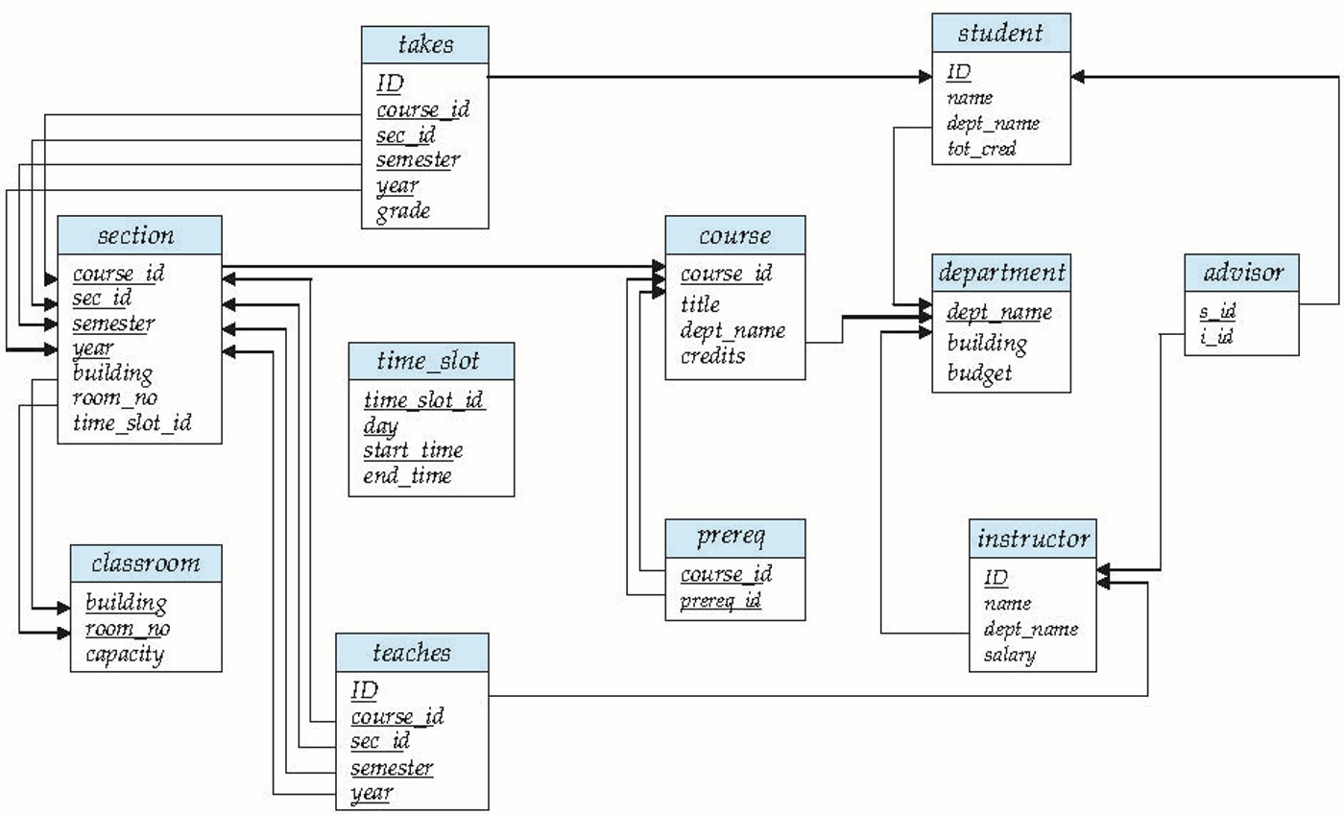
Trigger to Maintain credits_earned value
create trigger credits_earned after update of takes on (grade)
referencing new row as nrow
referencing old row as orow
for each row
when nrow.grade <> ’F’ and nrow.grade is not null
and (orow.grade = ’F’ or orow.grade is null)
begin atomic
update student
set tot_cred= tot_cred +
(select credits
from course
where course.course_id= nrow.course_id)
where student.id = nrow.id;
end;

Slide 42
Trigger to Maintain credits_earned value
Mariadb/Mysql version
DELIMITER //
create trigger credits_earned after update on takes
for each row
begin
if new.grade<>'F' and new.grade is not null
and (old.grade = 'F' or old.grade is null) then
update student set tot_cred= tot_cred + (select credits from course where course.course_id= new.course_id) where student.id = new.id;
end if;
end //
DELIMITER ;

Slide 43
Statement Level Triggers
Instead of executing a separate action for each affected row, a single action can be executed for all rows affected by a transaction
  Use for each statement instead of for each row
  Use referencing old table or referencing new table to refer to temporary tables (called transition tables) containing the affected rows
  Can be more efficient when dealing with SQL statements that update a large number of rows

Slide 44
Triggers Alternatives
Triggers were used earlier for tasks such as
  Maintaining summary data (e.g., total salary of each department)
  Replicating databases by recording changes to special relations (called change or delta relations) and having a separate process that applies the changes over to a replica
There are better ways of doing these now:
  Databases today provide built in materialized view facilities to maintain summary data
  Databases provide built-in support for replication
Encapsulation facilities can be used instead of triggers in many cases
  Define methods to update fields
  Carry out actions as part of the update methods instead of
  through a trigger

Slide 45
When Not To Use Triggers
Risk of unintended execution of triggers, for example, when
  Loading data from a backup copy
  Replicating updates at a remote site
  Trigger execution can be disabled before such actions.
Other risks with triggers:
  Error leading to failure of critical transactions that set off the trigger
  Cascading execution

Slide 46
Advanced Aggregation Features

Slide 47
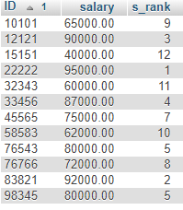
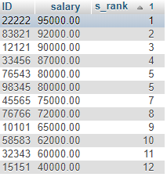
Ranking
Ranking is done in conjunction with an order by specification.
Find the rank of instructors based on their salary.
select ID, salary, rank() over(order by salary desc) s_rank from instructor
Sometimes an extra order by clause is needed to get them in sorted order
select ID, salary, rank() over(order by salary desc) s_rank from instructor order by s_rank

Slide 48
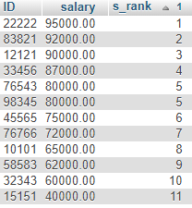
Ranking
Ranking may leave gaps: e.g. if 2 instructors have the same salary,
For example, two instructors have salary 80000 both have rank 5 , and the next rank is 7
  dense_rank() does not leave gaps, so next dense rank would be 2
Using rank()
Using dense_rank()

Slide 49
End

Slide 50
OLAP

Slide 51
Data Analysis and OLAP
Online Analytical Processing (OLAP)
  Interactive analysis of data, allowing data to be summarized and viewed in different ways in an online fashion (with negligible delay)
  Allow to view different summaries of multidimensional data.
  online indicates that an analyst must be able to request new summaries and get responses online, within a few seconds, and should not be forced to wait for a long time to see the result of a query.
Data that can be modeled as dimension attributes and measure attributes are called multidimensional data.
  Measure attributes
    measure some value
    can be aggregated upon
    e.g., the attribute number of the sales relation
  Dimension attributes
    define the dimensions on which measure attributes (or aggregates thereof) are viewed
    e.g., attributes item_name, color, and size of the sales relation

Slide 52

Example sales relation
...
...
...
...
...
...
...
...

Slide 53

Cross Tabulation of sales by item_name and color
The table above is an example of a cross-tabulation (cross-tab), also referred to as a pivot-table.
  Values for one of the dimension attributes form the row headers
  Values for another dimension attribute form the column headers
  Other dimension attributes are listed on top
  Values in individual cells are (aggregates of) the values of the
  dimension attributes that specify the cell.

Slide 54

Data Cube
A data cube is a multidimensional generalization of a cross-tab
Can have n dimensions; we show 3 below
Cross-tabs can be used as views on a data cube

Slide 55

Hierarchies on Dimensions
Hierarchy on dimension attributes: lets dimensions to be viewed at different levels of detail
  E.g., the dimension DateTime can be used to aggregate by hour of day, date, day of week, month, quarter or year

Slide 56
Online Analytical Processing Operations
Pivoting: changing the dimensions used in a cross-tab
Slicing: creating a cross-tab for fixed values only
  Sometimes called dicing, particularly when values for multiple dimensions are fixed.
Rollup: moving from finer-granularity data to a coarser granularity
Drill down: The opposite operation - that of moving from coarser-granularity data to finer-granularity data

Slide 57

Cross Tabulation With Hierarchy
Cross-tabs can be easily extended to deal with hierarchies
  Can drill down or roll up on a hierarchy

Slide 58

Relational Representation of Cross-tabs
Cross-tabs can be represented as relations
  We use the value all is used to represent aggregates.
  The SQL standard actually uses null values in place of all despite confusion with regular null values.

Slide 59
Extended Aggregation to Support OLAP
Please go through some queries from 5.6.3

Slide 60
End of Chapter 5

